Slide 1


Optimizing Network Performance with Wireshark and PRTG
Prsented by:
Hesham Ahmed Yousif Ahmed

Slide 2

Why Wireshark?
Wireshark used to capture & break down all the information into tiny pieces, so people can look at each one closely and ﬁnd any weird stuff going on. It's a must-have tool for keeping networks running smoothly and securely.

Slide 3

What Functionalities?
1. Packet Capturing
2. Protocol Analysis
3. Filtering and Search 4. Packet Decoding
5. Statics and Graphing

Slide 4
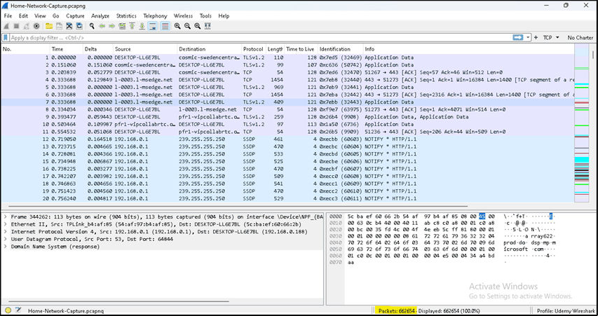
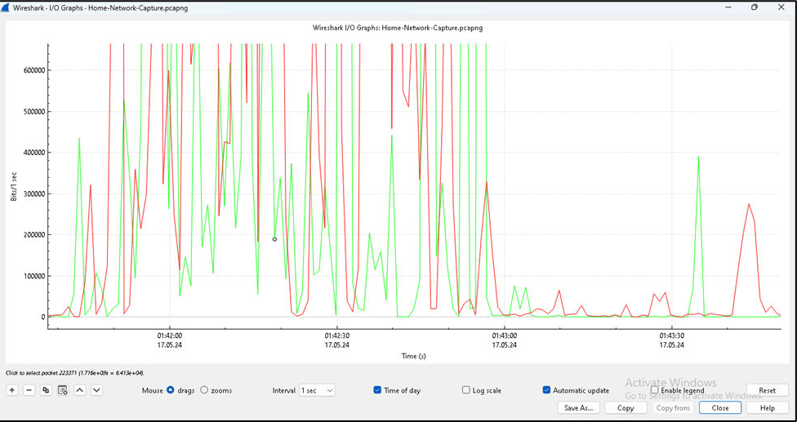
Monitoring Network with Wireshark
Some captured packets of my home network. And you can see the total number of packets captured (662654).
Here we want to compare which protocol consuming bandwidth more.

Slide 5
You can enable name resolution
As you can see to the right, now you are able to see which endpoint is consuming more bandwidth with its domain name.

Slide 6
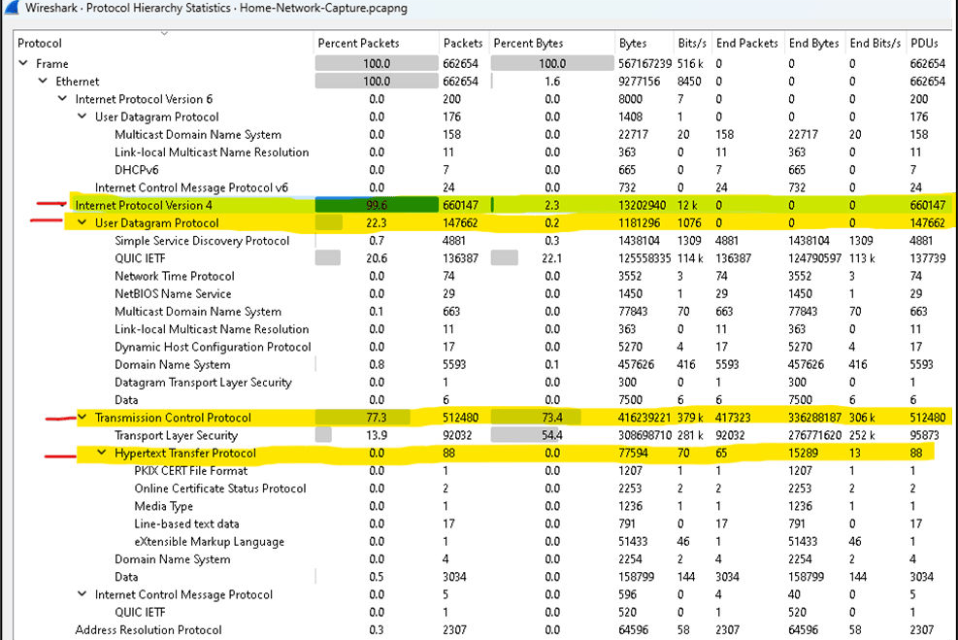
Bandwidth used by each protocol
In the ﬁgure, we can see that all packets are using IPv4. At the transport layer, TCP takes the largest share with 77.3 percent.
UDP accounts for only 22.3 percent, and HTTP is just 0.0 percent

Slide 7

Paessler Router Traffic Grapher
(PRTG) Network Monitor is network management software for bandwidth, usage, and availability monitoring. This technology runs on a Windows machine within the network and can automatically discover devices and collect various statistics.

Slide 8
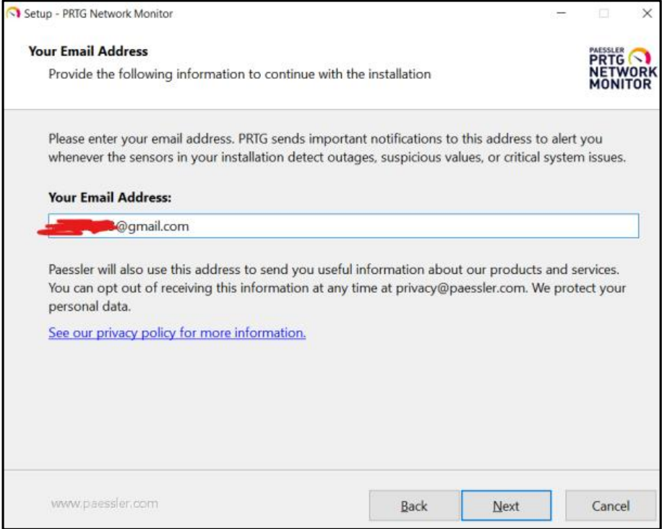
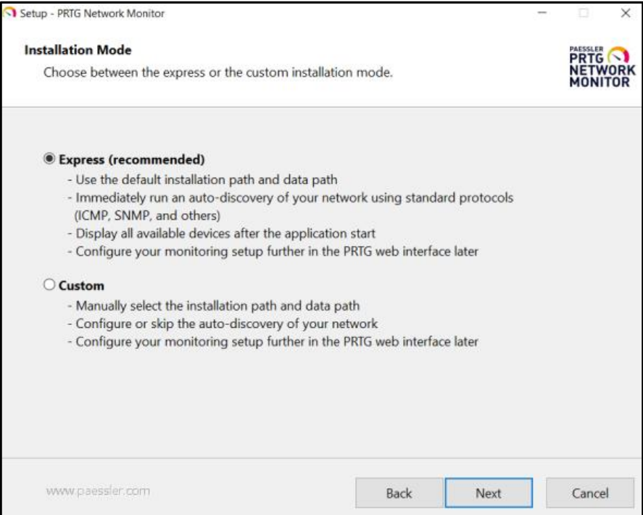
Easy to install and configure using auto-discovery

Slide 9
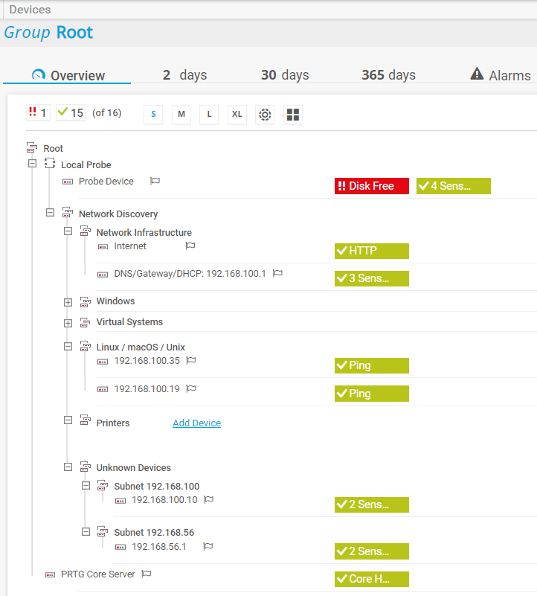
The home network consists of various devices, including routers, switches, wireless access points, and connected clients PRTG is monitoring the critical network components to ensure optimal performance.

Slide 10
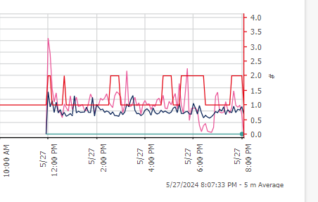
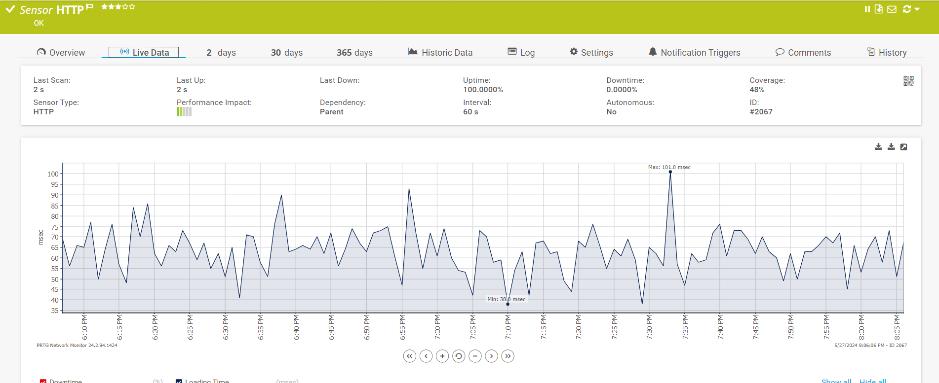
Real-time Performance
Monitoring
Implementing real time network performance monitoring with PRTG . Identify and respond to performance issue as they occur. Ensure consistent network reliability and uptime.

Slide 11
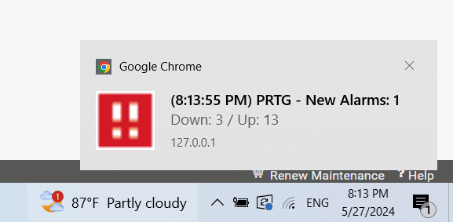
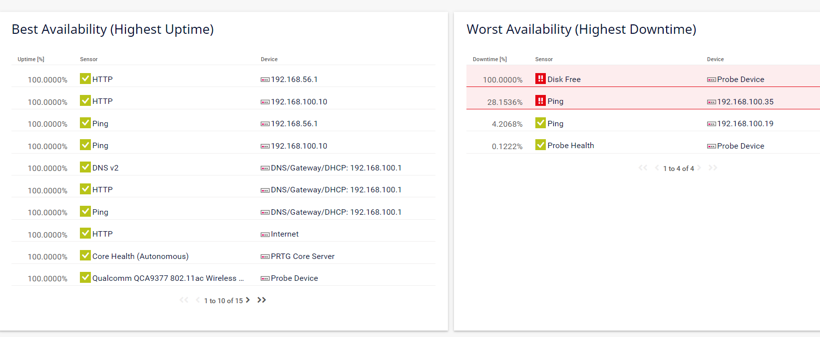
Alarm system and uptime and downtime status and bandwidth usage

Slide 12

Advantage of Paessler PRTG:
Free version available
Detailed dashboard
Auto-configure feature
Fast response customer service
Quick notification system
Disadvantages of Paessler PRTG:
windows based specifically
Not free after 30 days.
Limited scalability for large networks

Slide 13
Advantage of Wireshark:
Powerful Packet Analysis Capabilities
Real-time Monitoring
Shows Detailed Information
Disadvantages of Wireshark:
Hard for Beginners
Needs Lots of Computer Power

Slide 14
Conclusion
Harness the power of Wireshark and PRTG to optimize network performance. Empower your organization with in- depth network analysis, monitoring, and optimization. Ensure a good and efﬁcient network infrastructure.

Slide 15
Thanks!
Do you have any questions?

